Slide 1
Priority Queues
Computer Science, Purdue University
Copyright WILEY, Goodrich and Tamassia, Data Structures And Algorithms

Slide 2
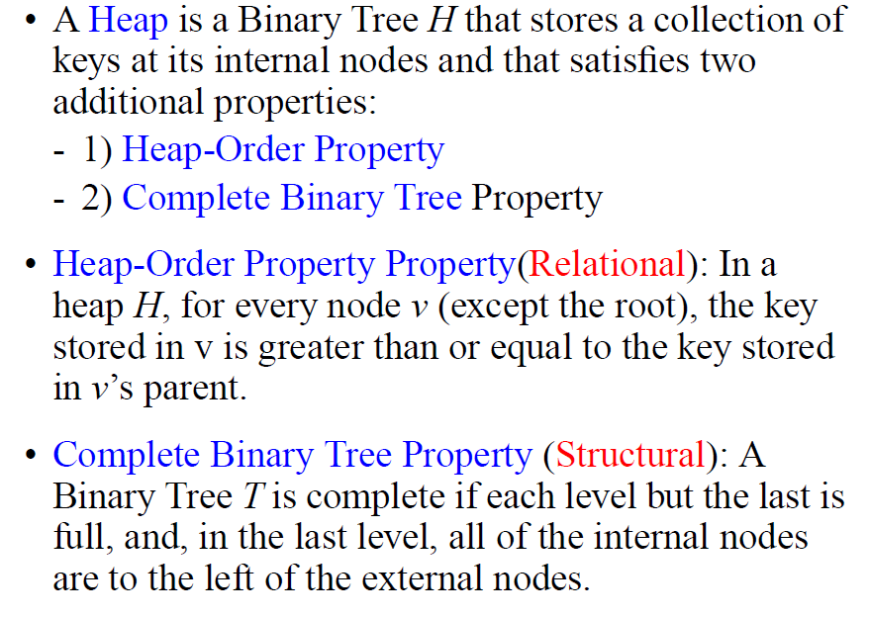
Priority Queues
Heaps
Computer Science, Purdue University

Slide 3
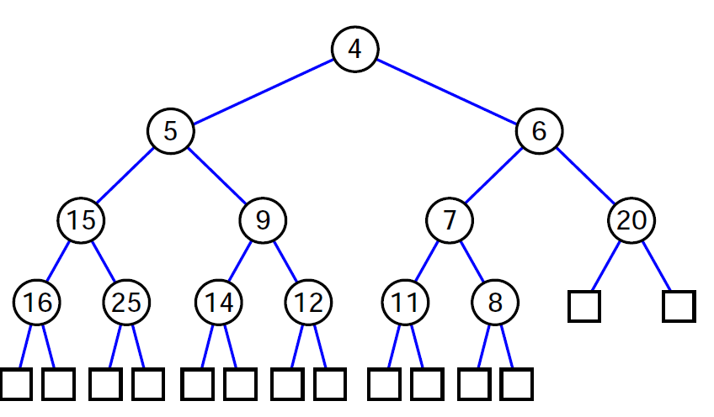
Priority Queues
Heaps
Computer Science, Purdue University

Slide 4
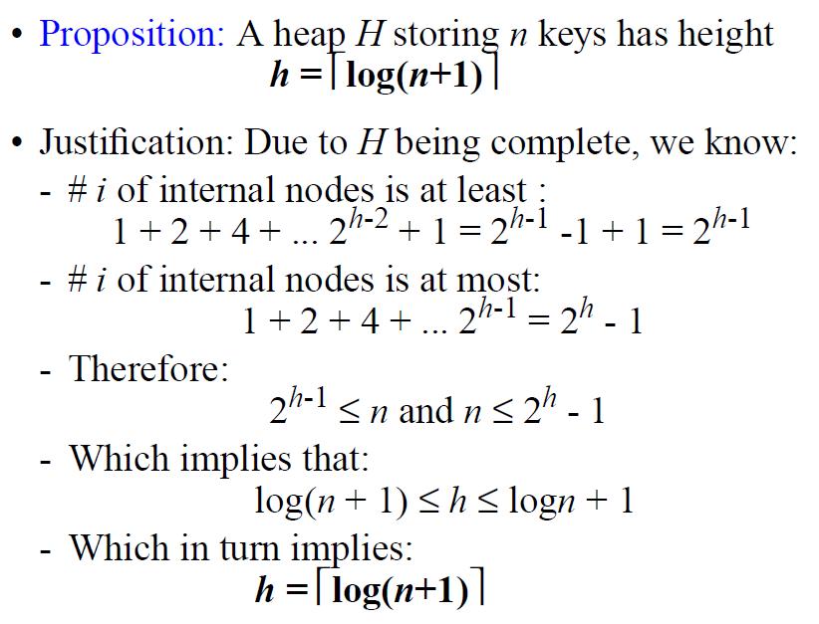
Priority Queues
Height of a Heap
Computer Science, Purdue University

Slide 5
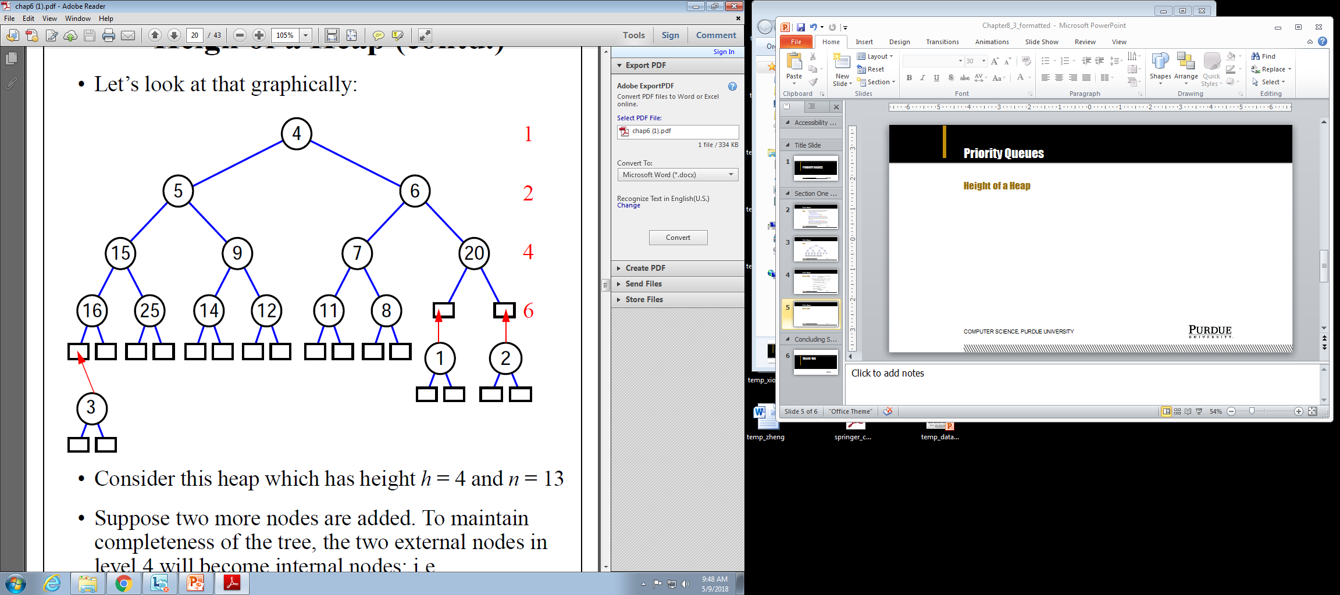
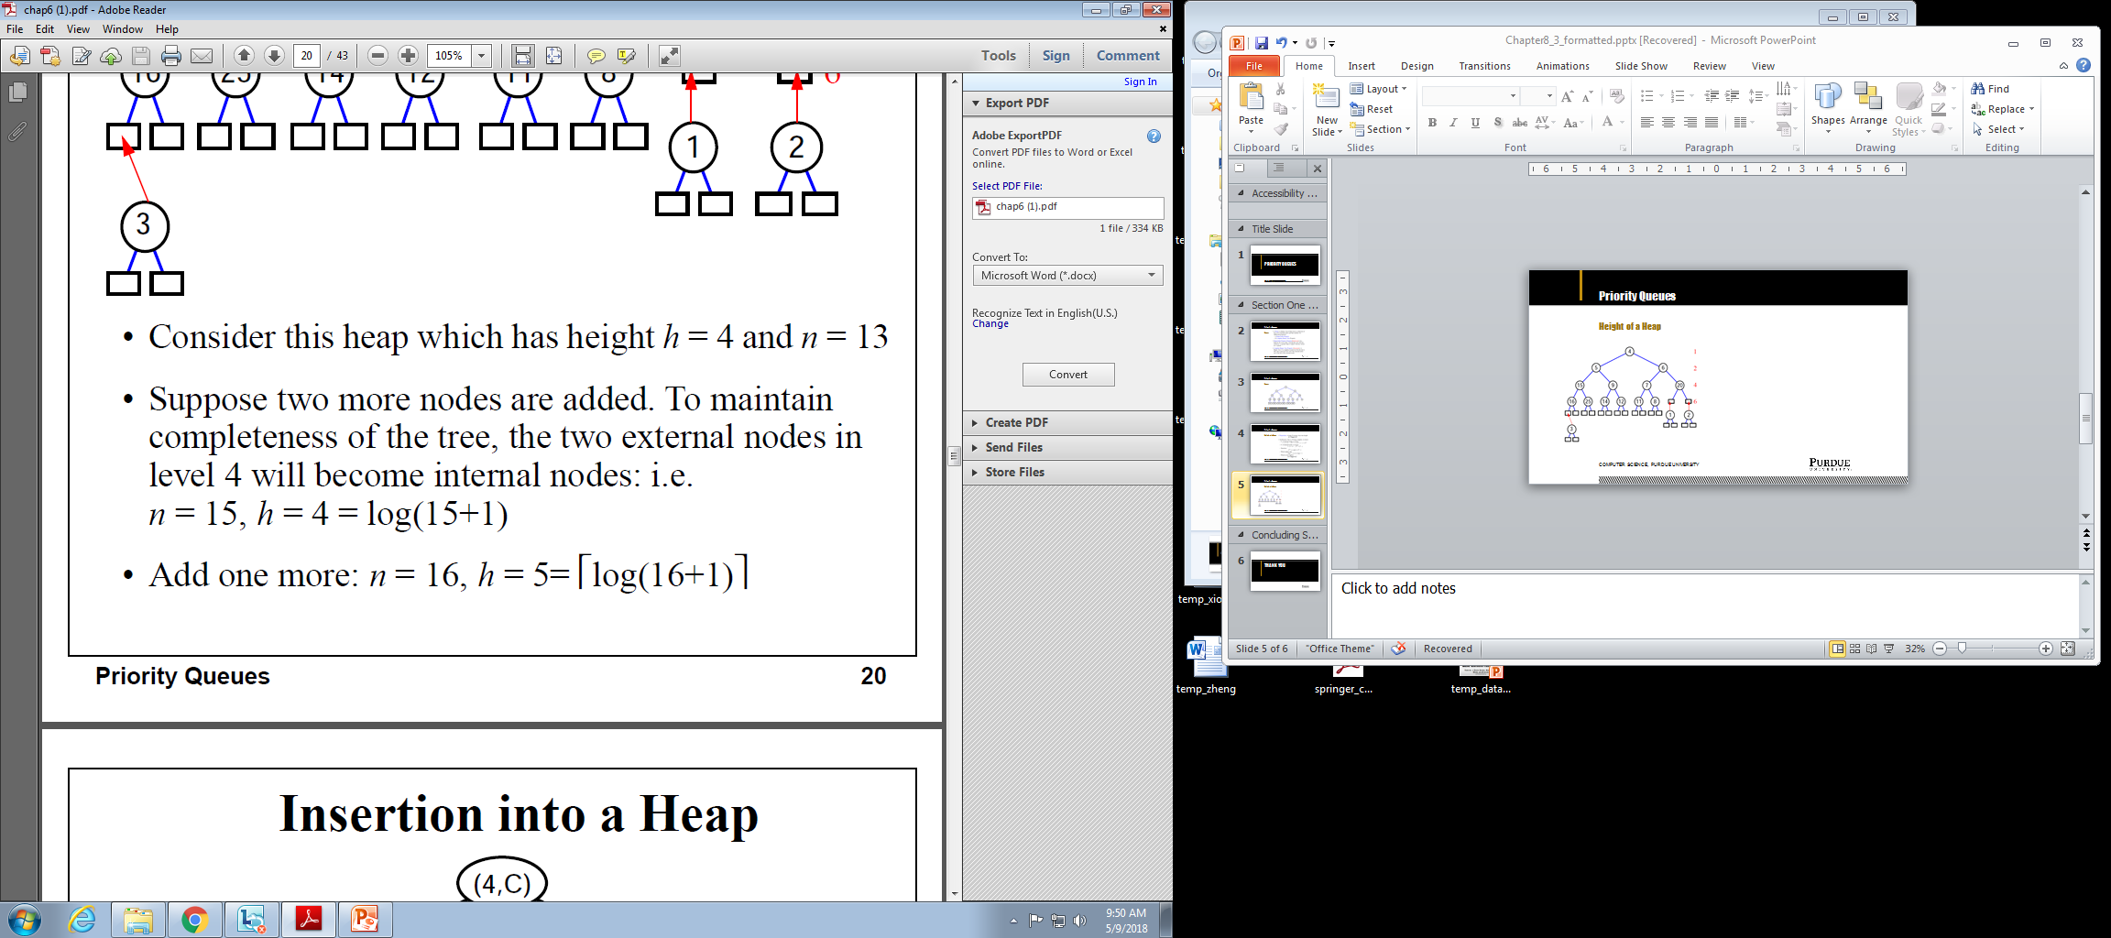
Priority Queues
Height of a Heap
Computer Science, Purdue University

Slide 6
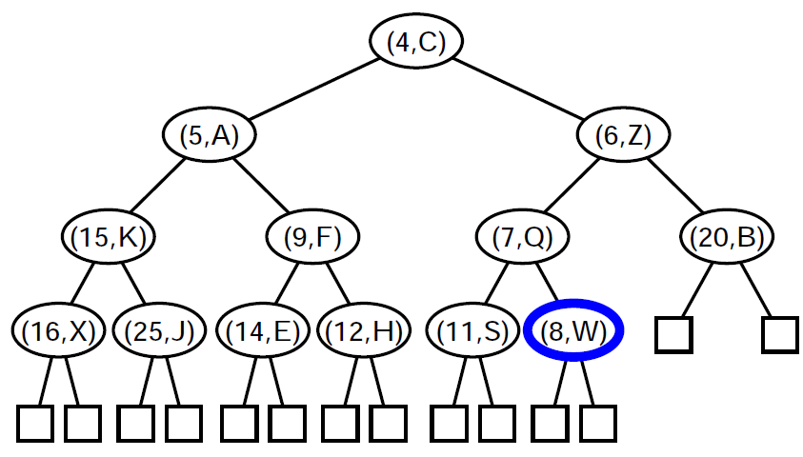
Priority Queues
Insertion into a Heap
Computer Science, Purdue University

Slide 7
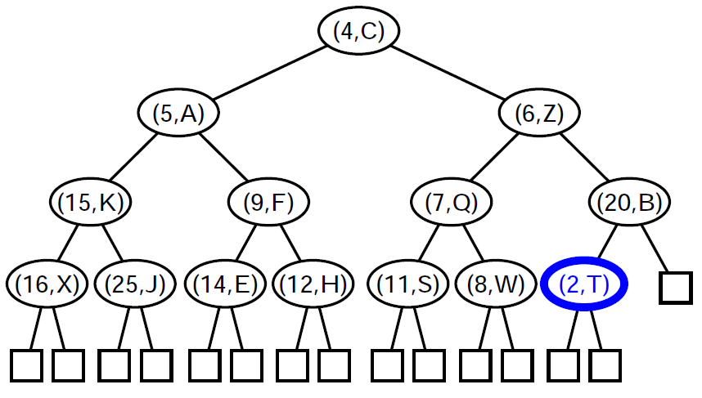
Priority Queues
Insertion into a Heap
Computer Science, Purdue University

Slide 8
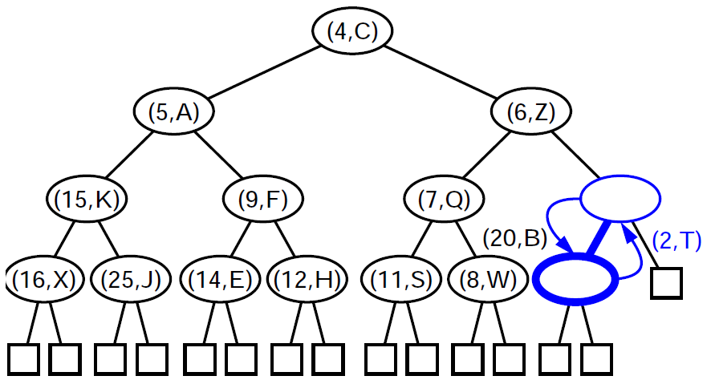
Priority Queues
Insertion into a Heap
Computer Science, Purdue University

Slide 9

Priority Queues
Insertion into a Heap
Computer Science, Purdue University

Slide 10
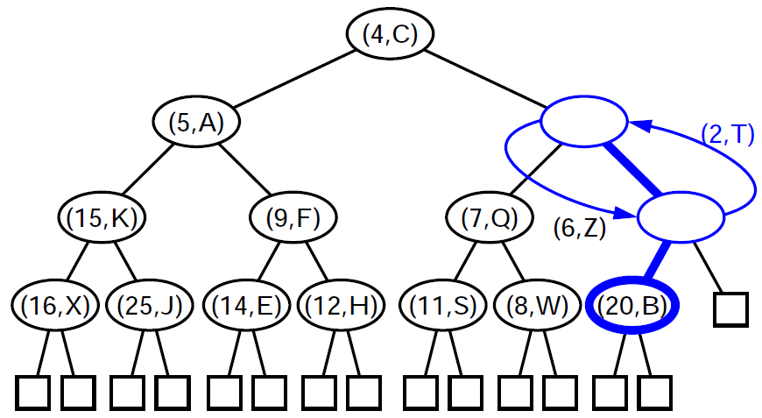
Priority Queues
Insertion into a Heap
Computer Science, Purdue University

Slide 11
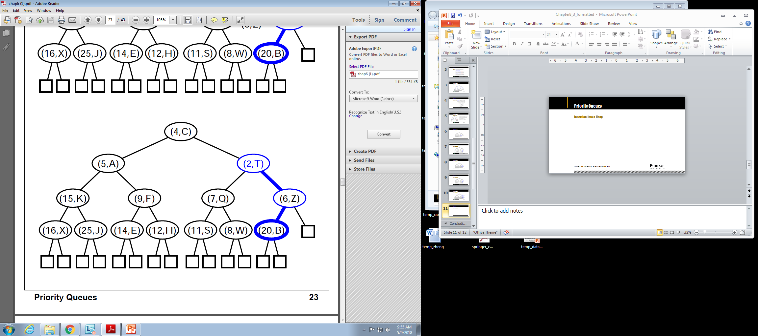
Priority Queues
Insertion into a Heap
Computer Science, Purdue University

Slide 12
Priority Queues
Insertion into a Heap
Computer Science, Purdue University

Slide 13
Priority Queues
Insertion into a Heap
Computer Science, Purdue University

Slide 14
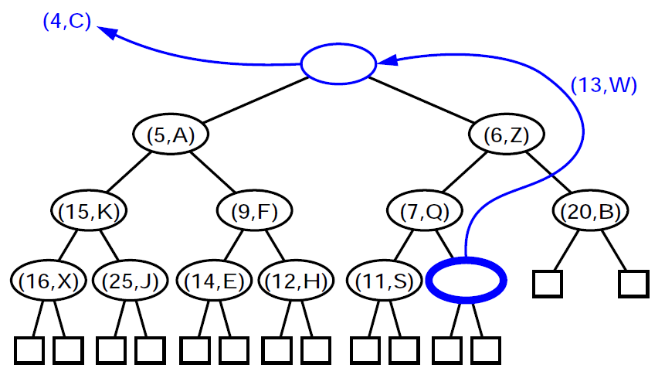
Priority Queues
Removal From a Heap
Computer Science, Purdue University

Slide 15
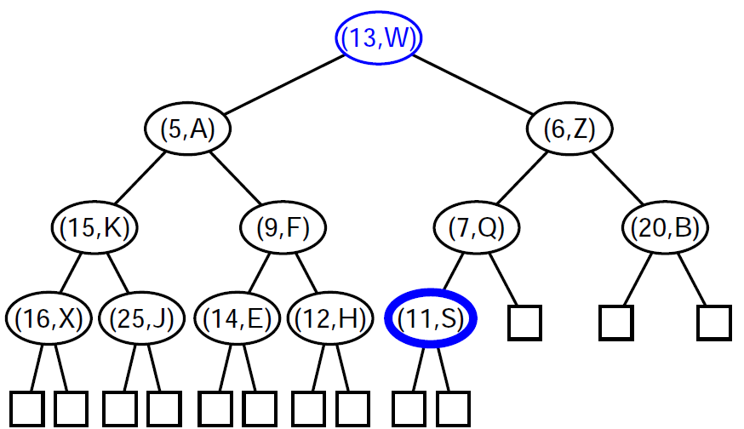
Priority Queues
Removal From a Heap
Computer Science, Purdue University

Slide 16
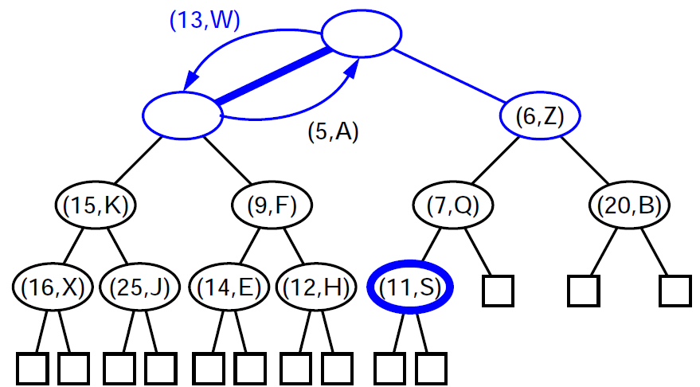
Priority Queues
Removal From a Heap
Computer Science, Purdue University

Slide 17
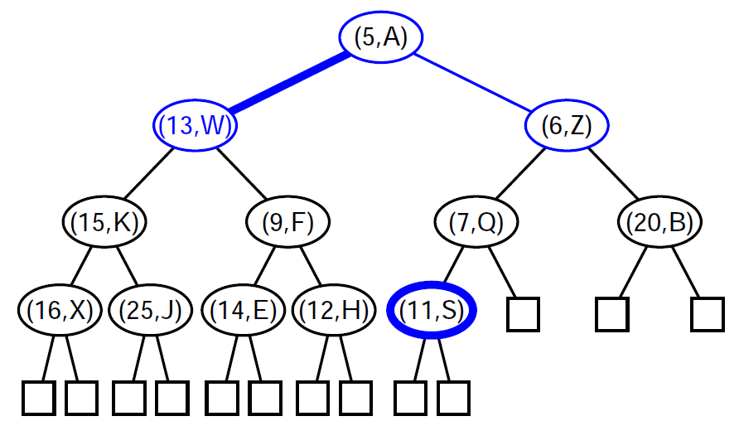
Priority Queues
Removal From a Heap
Computer Science, Purdue University

Slide 18
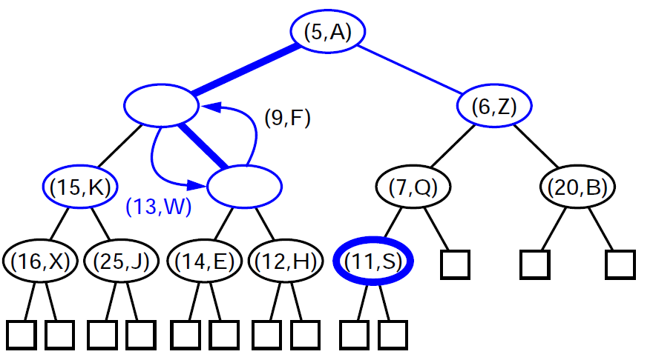
Priority Queues
Removal From a Heap
Computer Science, Purdue University

Slide 19
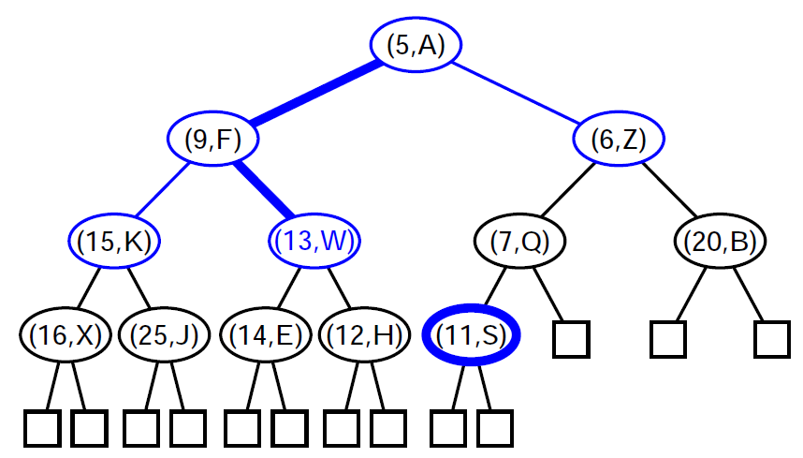
Priority Queues
Removal From a Heap
Computer Science, Purdue University

Slide 20
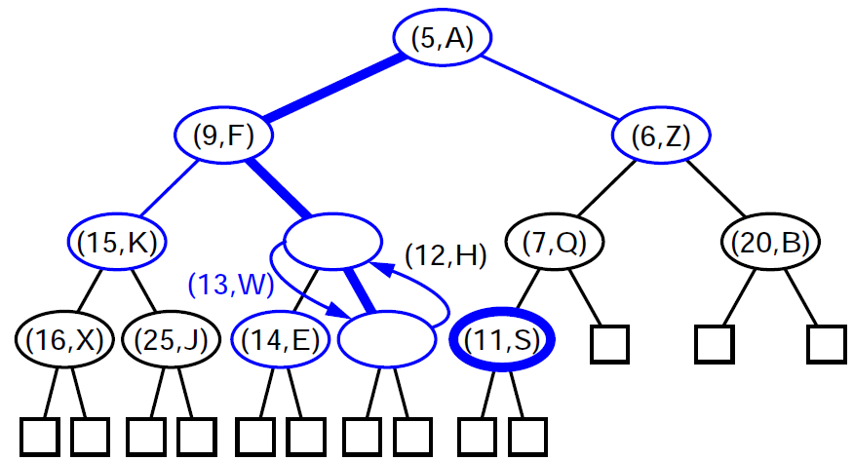
Priority Queues
Removal From a Heap
Computer Science, Purdue University

Slide 21
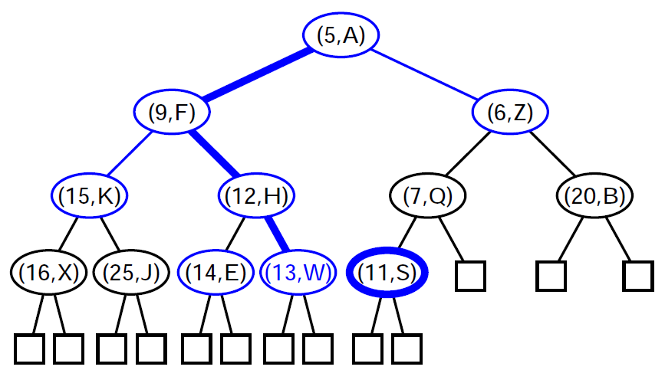
Priority Queues
Removal From a Heap
Computer Science, Purdue University

Slide 22

Priority Queues
Heap: Complexities
Computer Science, Purdue University

Slide 23
Thank You

